Slide 1

BLIM Labs
HACKATHON
September 11, 2018

Slide 2
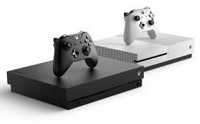
Value Proposition
BLIM Labs product provides an interoperable framework for you the gamer to own your status based on the rarity of your achievements.
Your complete gaming profile will be showcased publicly for others to view.

Slide 3





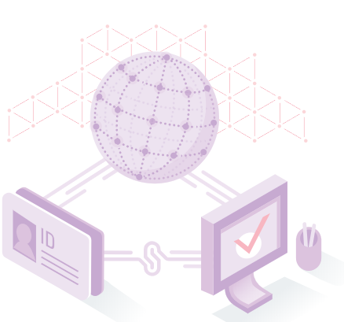

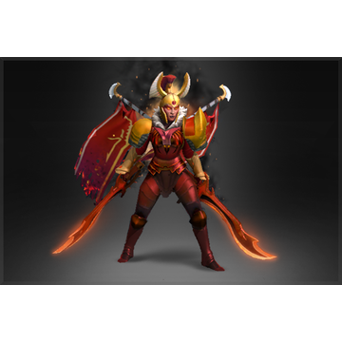
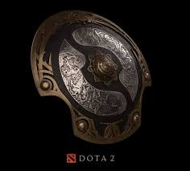

Architecture Framework
Trust Anchors
USER STATUS & OWNERSHIP
Quantity of Badges
Rarity of Badges
Know your Customer (KYC)
User Verification
Interface
PRIME Trust Anchor & Complete User Wallet

Slide 4





Standardized Rarity Score
Badges are standardized based off of rarity of ownership.
90-100% Ownership: 1 rarity point
.
.
.
0-10% Ownership: 10 rarity points

Slide 5
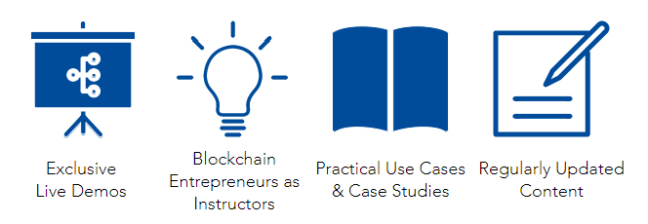
Demo

Slide 6
Thank you
Ivan Svirid (maelstrom.network)
Malcolm MacKay
Barry Bratt
Lori Kong
BLIM Labs

